Slide 1


movieAPI Demo Presentation
By
Aizuddin 23012
Thurgashhini 23294
Muginesh Kumar 23282

Slide 2
Overview
This project is to see how the flow of using lambda function over the server by utilizing the API.
We are implementing GET method which is used to request data from a specified (is: lambda) .

Slide 3
Features
For API Gateway, need to create resource and under resource need to create method (in this case we are pointing the GET method)
For Lambda, need to create the function using standard node.js runtime and run some code within the editor itself.

Slide 4
Usage Examples
Google Maps API: Google Maps APIs lets developers embed Google Maps on webpages using a JavaScript or Flash interface. The Google Maps API is designed to work on mobile devices and desktop browsers.
YouTube APIs: YouTube API: Google's APIs lets developers integrate YouTube videos and functionality into websites or applications. YouTube APIs include the YouTube Analytics API, YouTube Data API, YouTube Live Streaming API, YouTube Player APIs and others.
3. Flickr API: The Flickr API is used by developers to access the Flick photo sharing community data.

Slide 5
Scalability
Lambda and API Gateway consequently scale to deal with changes in load, without expecting to arrangement additional limit.
The main concern is consider pre-cautioning these administrations before significant press occasions that could prompt an extreme burden spike.

Slide 6
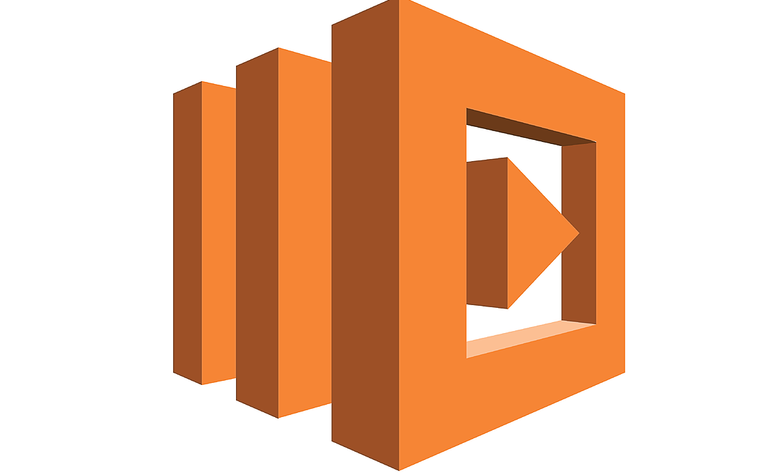

Services
Amazon Lambda enable us to run code for virtually any type of application or backend service - all with zero administration.
API Gateway All requests from clients first go through the API Gateway. It then routes requests to the Amazon Lambda.

Slide 7
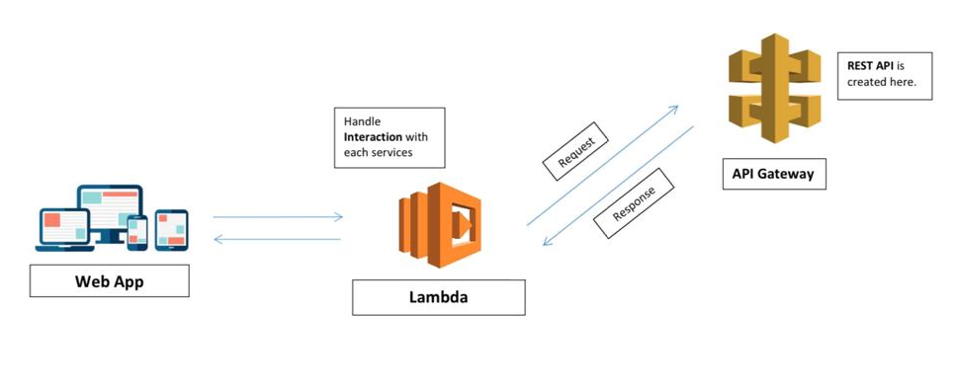
Architecture

Slide 8
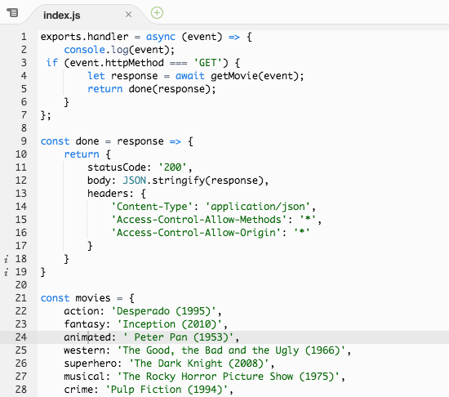
Lambda Coding

Slide 9
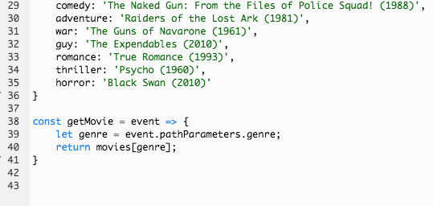
Lambda Coding

Slide 10
Thank you

